Slide 1
Creational Patterns in C#
Nataliia Svystun
Notes:
All 23 design patterns (including 5 creational patterns) were described in book by Gang of four (Erich Gamma, Richard Helm, Ralph Johnson and John Vlissides) in 1994.
But today, today we’re going to talk about only Creational Patterns in C#.

Slide 2
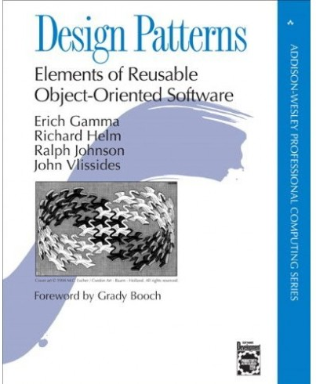
Agenda
Abstract Factory
Builder
Factory Method
Prototype
Singleton
Notes:
We’ll find out about kind of creational patterns such as Abstract Factory, Builder, Factory Method, Prototype, Singleton.
Creational patterns allow you to hide work with specific classes and details how these classes are created and docked. The only known object information is the interfaces of these objects given through abstract classes. This simplifies understanding of the processes of creating objects: when, how, who and what creates.

Slide 3
Agenda
Abstract Factory (Kit)
Builder
Factory Method
Prototype
Singleton
Notes:
So, let’s start.
The Abstract Factory pattern also known as Kit (set of tools).
The Abstract Factory pattern provides the client with an interface (set of methods) to create families of interconnected or interdependent product objects, while hiding from the client information about specific classes of created object-products.

Slide 4

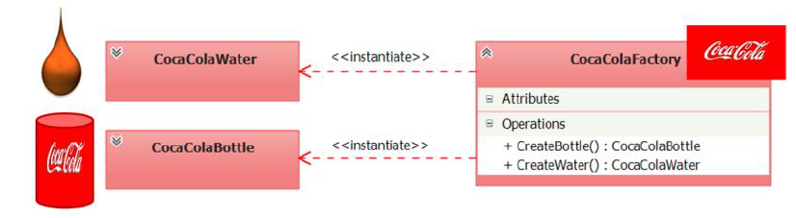
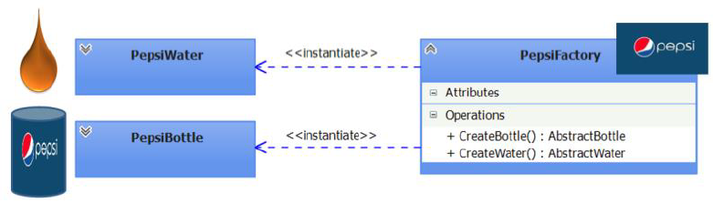
Abstract Factory (Kit)
Notes:
What is a factory in objective reality? A factory is an object having machines (methods) that produce products. For example, the Coca-Cola factory produces sweet soda water poured into tin cans. Suppose that there are two machines in the factory premises. One machine mixes and carbonates the sweet water, and the other machine forms tin cans. After the sweet water and tin can is produced, it is required to pour water into the jar, in other words, it is required to organize the interaction between two products: water and a jar. We describe this process using the UML class diagrams.
The diagram shows that the Coca-Cola factory generates two products: water and a jar. These products must necessarily interact with each other, otherwise water will be problematic to deliver to the consumer, no less than an empty bank the consumer is not needed. Associated products (water and a bank), produced by the Coca-Cola factory, form the family of products of the Coca-Cola factory.
Pepsi's factory also produces its own family of interacting and interdependent products (water and bank).
It is important to note that it is not logical to try to establish interaction between products from different families (for example, pour Coca-Cola water into a Pepsi bank or Pepsi water into a Coca-Cola bank). Most likely both manufacturers will be against such interaction. This approach is an example of an antipattern.

Slide 5
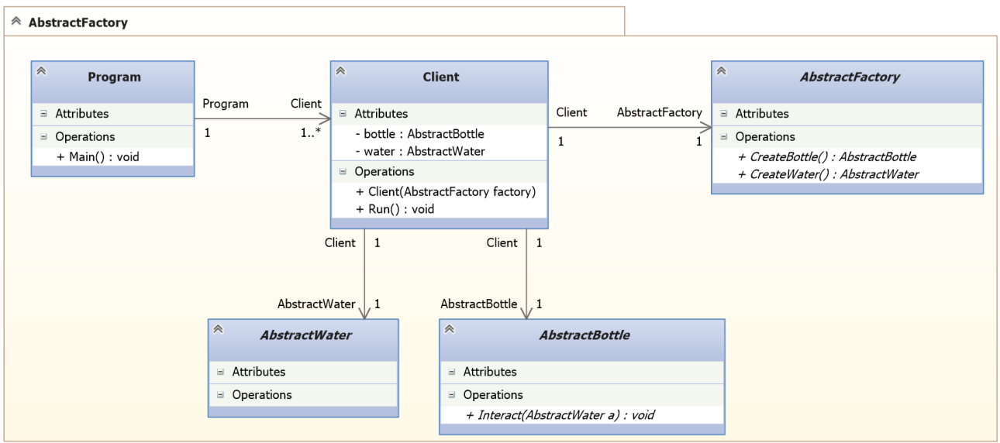
Abstract Factory
Notes:
Represent the reviewed factories and the product families they spawn in the context of one program.
First, you need to create abstract classes for specifying product types (AbstractWater and AbstractBottle) and factory type (AbstractFactory). Describe the interaction interfaces with each type of product and factory.
Next, you need to create a specific Client class in which you abstractly (without implementation) describe the processes for generating instances of product types and options for using these types of products, through their existing abstract interfaces. Also, the Client class implements the idea of ​​encapsulation variations (hiding parts of the software system).

Slide 6
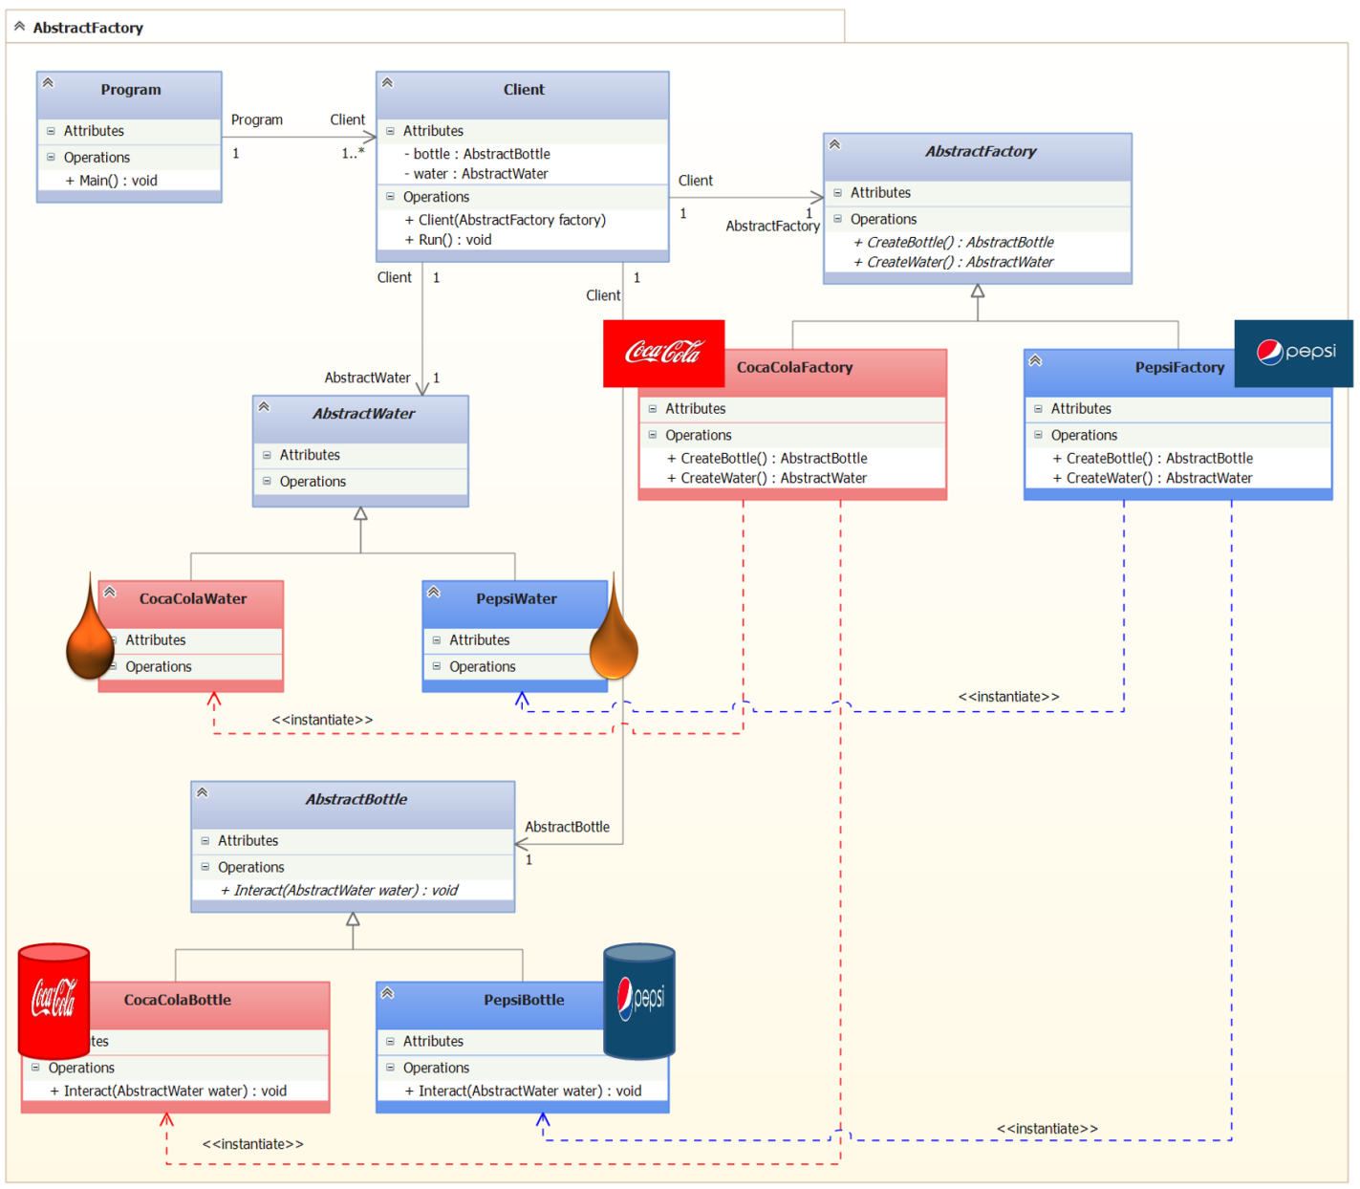

Slide 7
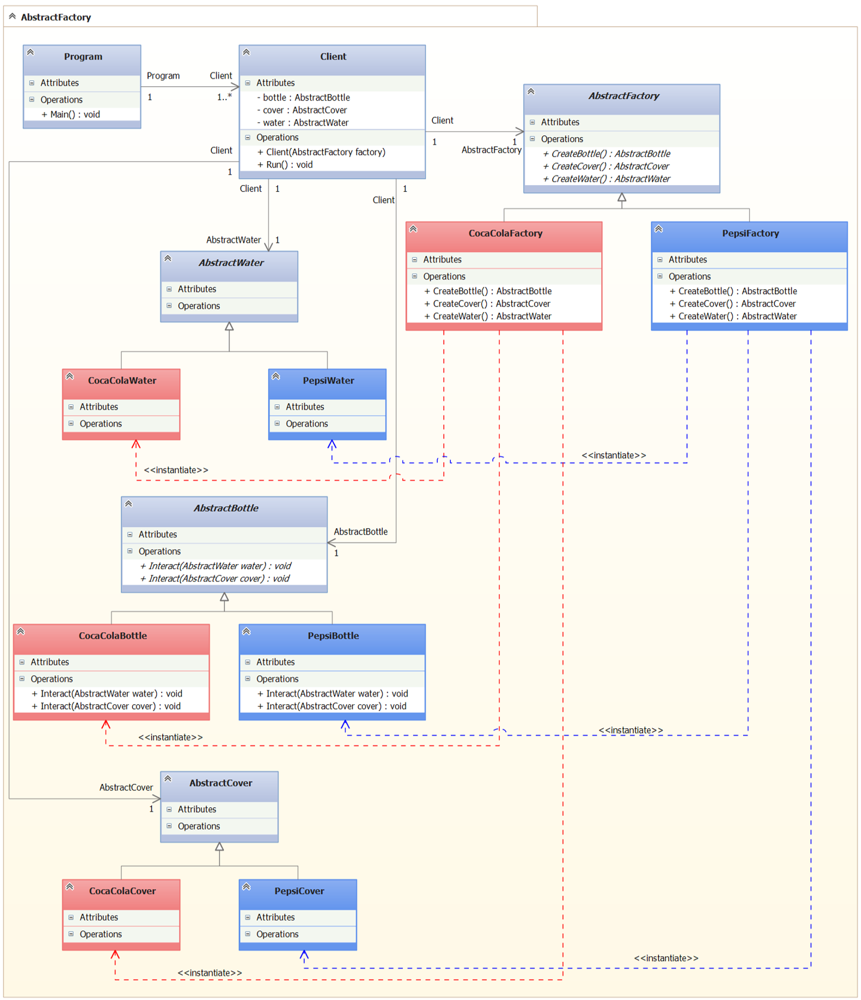
Notes:
Using this approach to product generation, now it is not difficult to add new types of products to the system (for example, the cover for closing the jars with water).

Slide 8
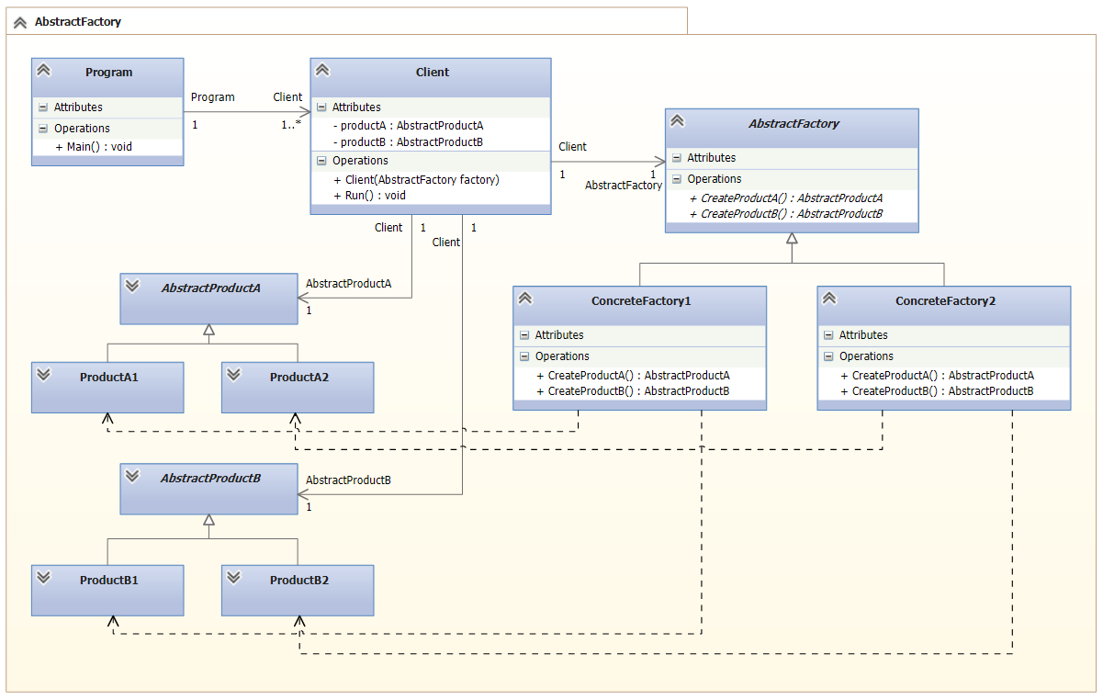
Abstract Factory UML

Slide 9
Abstract Factory
The Abstract Factory pattern has the following advantages:
Hiding work with specific classes of products.
Allows you to easily replace the family of products used.
Ensuring sharing of products.
Abstract Factory pattern has the following disadvantages:
There is a slight inconvenience in adding a new kind of product.
Notes:
The Abstract Factory pattern is recommended when:
It is required to create product objects of different types and establish interaction between them, thus forming families of these product objects. The product objects included in the family must be used together.
It is required to build a subsystem (module or component) in such a way that its internal device (state and / or behavior) is configured when it is created. At the same time, neither the process nor the result of building a subsystem was dependent on the way of creating objects in it, their composition (composing and connecting objects) and representation (adjusting the internal state of objects).
The subsystem or system must be configured (configured) through the use of one of the families of product objects generated by a single factory object.
The Abstract Factory pattern has the following advantages:
Hiding work with specific classes of products.
The factory hides from the client details of the implementation of specific classes and the process of creating instances of these classes. Specific product classes are known only to specific factories and they are not used in client code. The client manages instances of specific classes only through their abstract interfaces.
Allows you to easily replace the family of products used.
An instance of the class of a particular factory is created in the application in one place and only once, which makes it easier to replace the factories in the future. In order to change the family of products used, you just need to create a new instance of the factory class, then the entire family will be replaced at once.
Ensure the sharing of products.
It makes it easy to control the interaction between product objects that are designed for sharing and are part of the same family.
Abstract Factory pattern has the following disadvantages:
There is a slight inconvenience in adding a new kind of product.
To create a new type of products, you will need to create new product classes (abstract and concrete), add a new abstract factory method to the abstract factory class, and implement this abstract method in derived factory-specific factories, and modify the Client class code.

Slide 10
Agenda
Abstract Factory
Builder
Factory Method
Prototype
Singleton
Notes:
The Builder pattern helps to organize the step-by-step construction of a complex product object so that the client does not need to understand the sequence of steps and the internal structure of the product object being built, and as a result of the same design process, product objects with different representations (internal device).

Slide 11
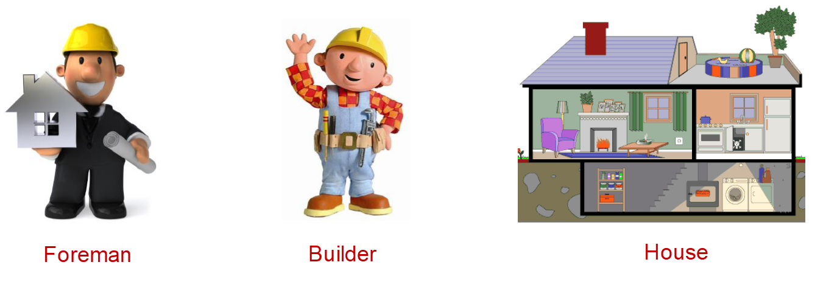
Builder
Who is a builder in objective reality?
Notes:
Who is a builder in objective reality? A builder is a person who builds buildings and structures (bridges, dams, tunnels, etc.). The result of the construction is the erected building (structure). In order for the building to be built according to the rules and in accordance with the design standards, the builders should be managed. The position of the head on the construction site is called the construction superintendent (short for "works"). The foreman instructs the builder how and in what order to carry out construction work. The Builder pattern is built on a similar metaphor.

Slide 12
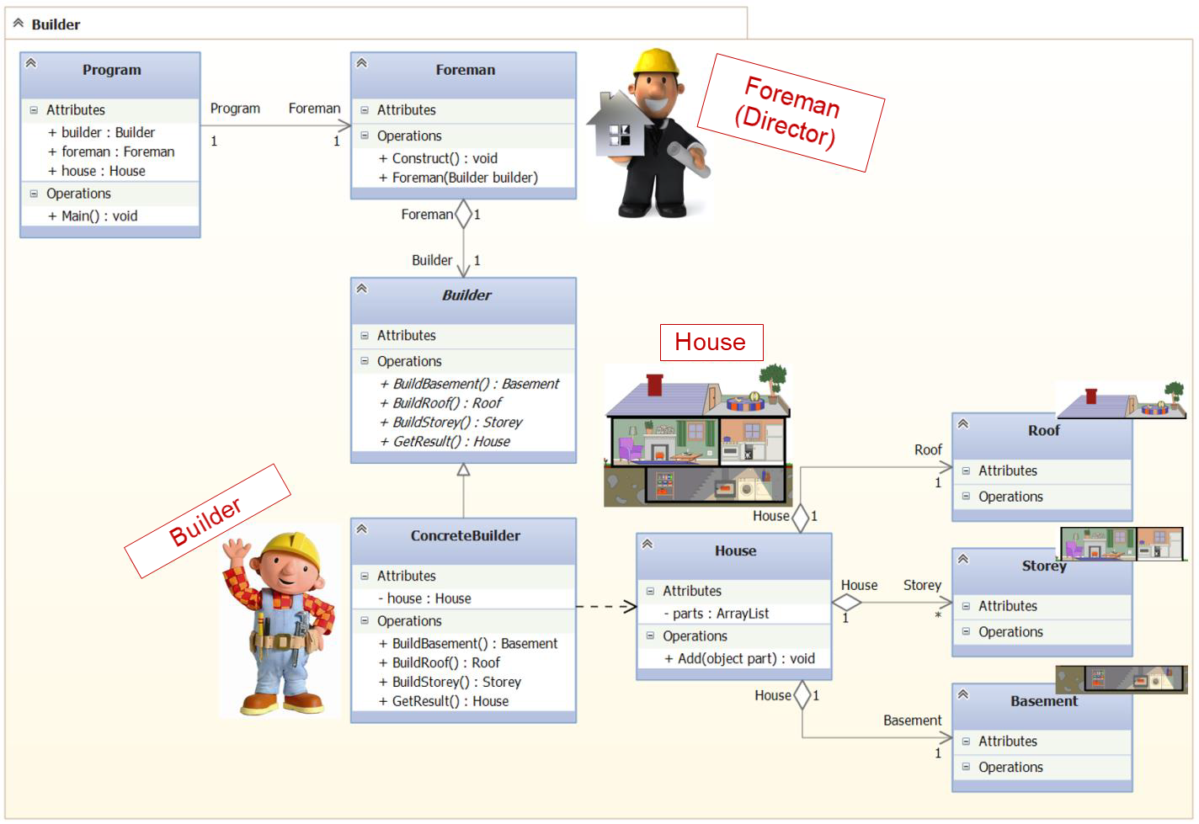
Notes:
Foreman, should give the builder instructions for building parts of the house in a certain sequence. For example:
1. "Build a basement,
2. "Build a storey",
3. "Build a roof".
The method of building a house determines the type of concrete builder. A bricklayer, who builds a house of brick will build a house in a different way, from a carpenter who will build a log house (wooden house) from logs. Thus, according to the project, the foreman must call the appropriate builder and give him the appropriate instructions in a certain order. First, build a basement, then a floor and, last but not least, a roof.

Slide 13
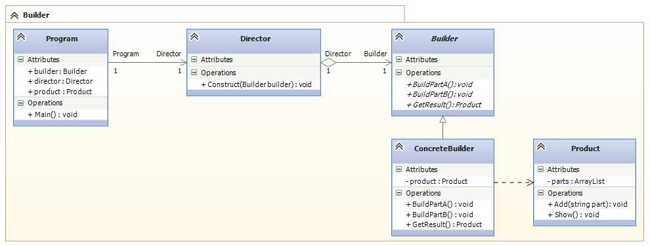
Builder UML

Slide 14
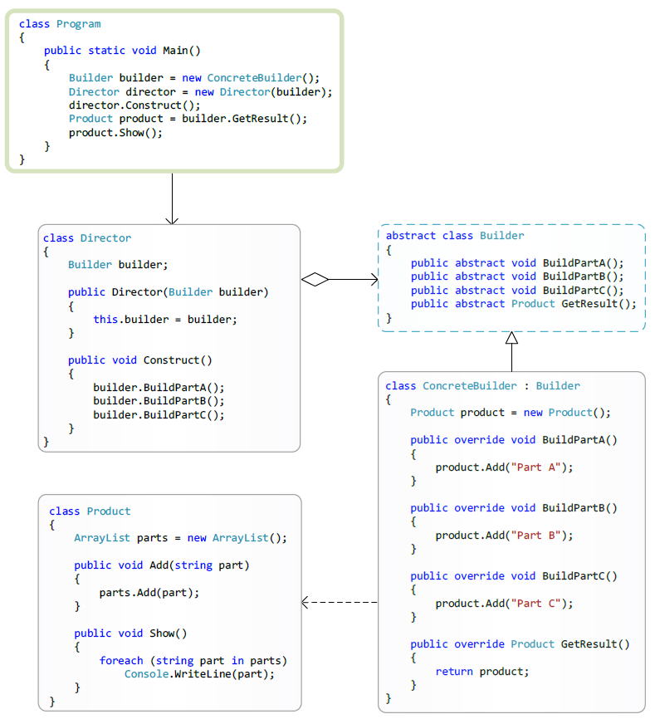
Builder
Notes:
The participants:
Product - It is a class of a complex-constructed product object and contains a set of methods for assembling the final product result from parts. The product class can be linked by relationships of aggregation relations, with classes that describe the constituent parts of the created product.
Builder - Abstract builder:
Provides a set of abstract methods (interface) for creating a product object from parts and getting the finished result.
ConcreteBuilder - Concrete builder:
Constructs a product object by collecting it from parts, implementing the interface specified by the abstract builder (Builder). Provides access to the finished product (returns the product to the client or in a special case to the director).
Director - Director (Manager):
Using the Builder interface, the director instructs the builder to build the product.

Slide 15
Builder
The Builder pattern has the following advantages:
Allows you to change the composition of the product.
Hides the code that implements the construction and presentation.
Provides full control over the process of building the product.
Notes:
The Builder pattern is recommended when:
The algorithm for step-by-step creation of a complex product object should not depend on the parts of the product object and how these parts fit together;
The process of creating a product should provide the possibility of obtaining various variations of the created product.
The Builder pattern has the following advantages:
Allows you to change the composition of the product.
The abstract class Builder provides the director with a set of abstract methods (abstract interface) for managing the construction of the product. Behind the abstract interface, Builder hides the internal structure of the created product and the process of building it. Since the product is built according to the abstract interface, it is enough to create a new type of builder to change the structure of the product;
Hides the code that implements the design and presentation.
The Builder pattern improves modularity by hiding the way that complex objects are constructed and presented. Clients do not know anything about the classes included in the internal structure of the product, the use of these classes is not available in the builder's interface. ConcreteBuilder's concrete builders contain the code needed to create and assemble a particular type of product. The code is written only once and different directors can reuse it to build different product variants from the same parts by combining these parts.
Provides full control over the process of building the product.
Unlike other generative patterns, which immediately construct the entire object-product completely, the builder builds the product step by step under the direction of the director. And only when the construction of the product is completed, the director or client takes it from the builder. Therefore, the builder's interface reflects the process of step-by-step product design more than other generative patterns. This allows you to ensure complete control over the design process, and therefore, over the internal structure (combination of parts) of the finished product.

Slide 16
Agenda
Abstract Factory
Builder
Factory Method
(Virtual Constructor)
Prototype
Singleton
Notes:
The Factory Method pattern also known as Virtual Constructor.
The Factory Method pattern provides an abstract interface (a set of methods) for creating a product object, but leaves the possibility for class developers implementing this interface to decide on their own which instance of a specific product class to create. The Factory Method pattern allows the underlying abstract classes to transfer responsibility for creating product objects to their derived classes.

Slide 17
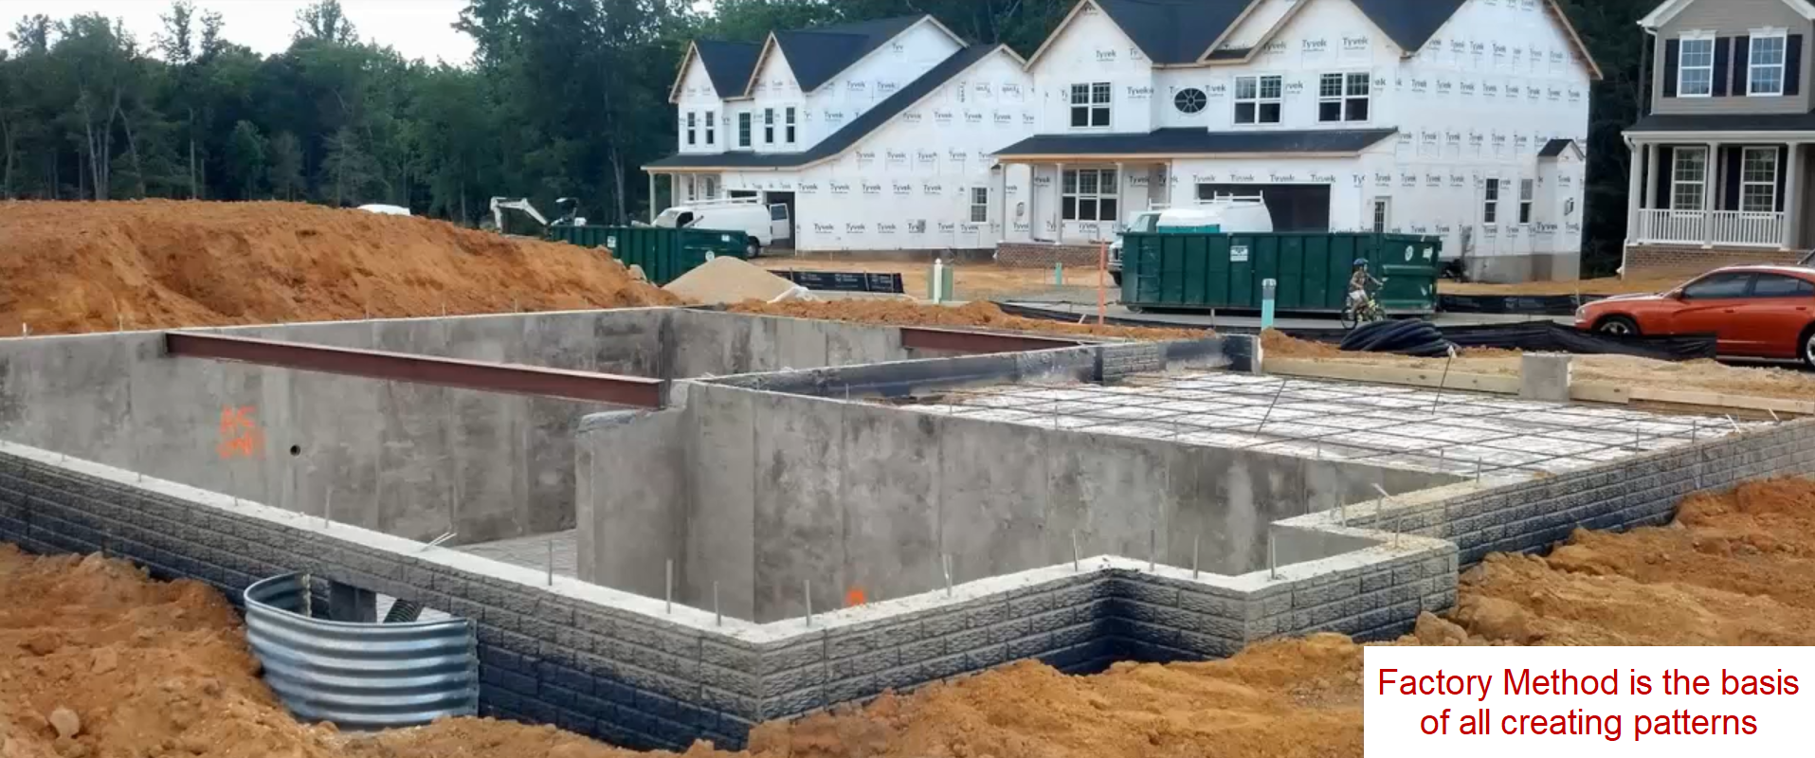
Factory Method
(Virtual Constructor)
Notes:
The Factory Method pattern underlies all creating patterns, organizing the process of creating product objects. If the designer at the design stage of the system can not immediately determine the appropriate pattern for organizing the process of creating the product in a particular situation, then first use the Factory Method pattern.
For example, if the designer does not determine the complexity of the product or the need and method of organizing the interaction between several products, then it makes sense to first use the Factory Method pattern. Later, when the requirements are formulated more clearly, it will be possible to quickly replace the Factory Method pattern with another generating pattern that is more appropriate for the design situation.
The main task of the Factory Method pattern is to organize the technique of delegating responsibility for creating product objects with one class (often abstract) to another class (derived from a particular class). In other words, an abstract class containing an abstract factory method, tells its derivative to a particular class: "A concrete class, I instruct your developer to choose a specific class of the generated product object independently when implementing my abstract factory method."

Slide 18
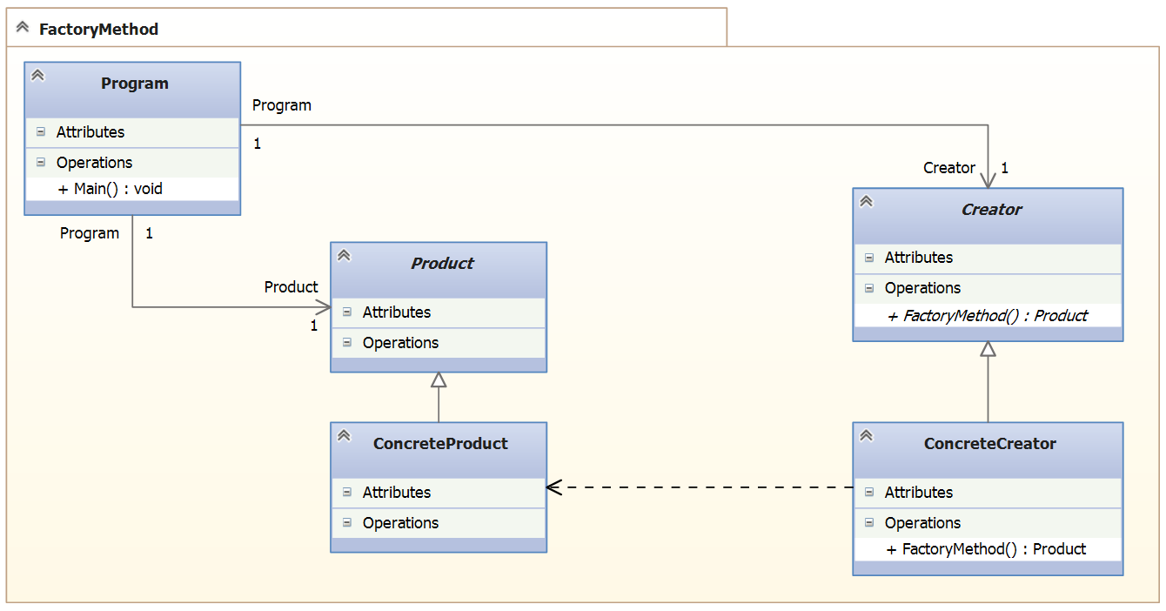
Factory Method UML
Notes:
The participants:
Product - Provides an interface for interacting with products.
Creator - Provides an interface (abstract factory methods) for generating products. In special cases, the Creator class can provide implementation of factory methods that return product instances (ConcreteProduct).
ConcreteProduct - Specific product: Implements the interface provided by the Product base class.
ConcreteCreator - Specific factory: Implements the interface (factory methods) provided by the base class Creator.

Slide 19
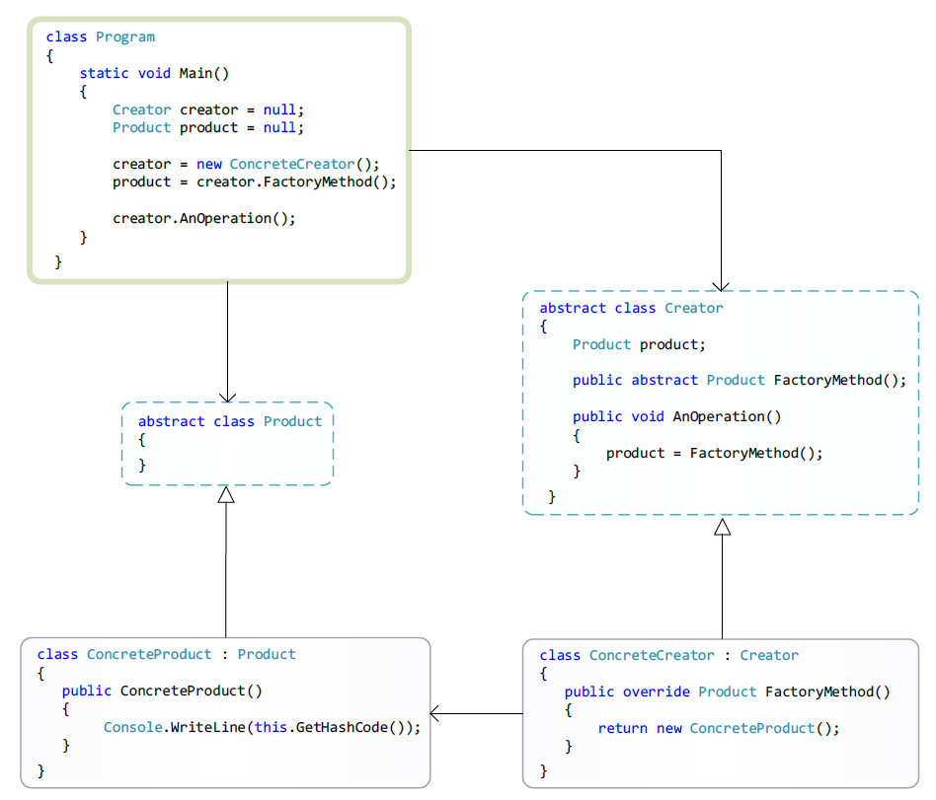

Slide 20
Factory Method
The Factory Method pattern is recommended when:
The abstract base class Creator is not known in advance, which specific classes of products will need to be created.
Abstract class Creator is designed so that the objects-products that you need to create are described by its derived classes (ConcreteCreator).
The process of creating a product should provide the possibility of obtaining various variations of the created product.
Abstract class Creator plans to transfer responsibility for creating object-products to one of its subclasses.
It is required to collect in one place (in the group of successors) all ConcreteCreators responsible for creating objects-products of a certain type.
Notes:
Using factory methods eliminates the need to use instance constructors to create product objects directly at the point of use of these product objects. Thus, it is possible to work with the abstract interface of the Product class, which in turn allows you to work with any products of specific ConcreteProduct classes derived from Product.

Slide 21
Agenda
Abstract Factory
Builder
Factory Method
Prototype
Singleton
Notes:
Pattern Prototype - provides the ability to create new objects-products (clones) using the technique of cloning (copying) the previously created object-original-product (prototype). Pattern Prototype - allows you to specify different kinds (classes-views) of product objects (clones), through setting the state of each newly created clone. Classification of clone products is based on the difference in their states.

Slide 22
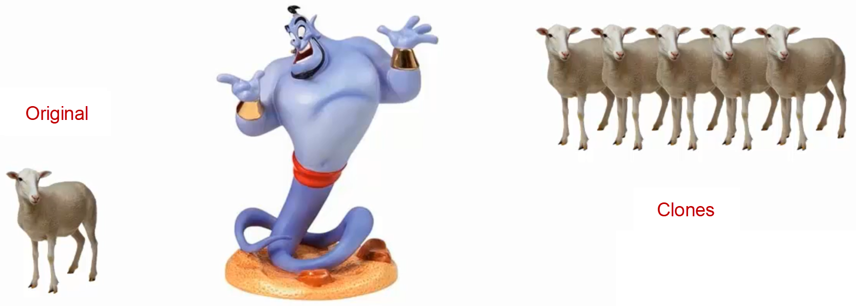
Prototype
Notes:
The Prototype pattern describes the process of correctly creating clone objects based on an existing prototype object, in other words, the Prototype pattern describes the correct ways to organize the cloning process.
What is cloning in objective reality? In biology, the term "cloning" refers to the processes of copying any living beings. But, in computer science, the term "cloning" has its own specific meaning, different from its meaning in biology. In biology, the cloning process occurs by creating a non-finished copy of an adult organism, but by growing an adult clone from an infant. Initially, the baby clone is generated on the basis of the genetic material of the prototype organism, and develops to the adult state in stages, according to the genetic development program laid down in it. In computer science, cloning takes place "instantly". As a result of cloning a prototype in computer science, we immediately get an "adult" clone completely identical to the prototype.
In life, software cloning of the analogy can not be found, since the biological organism-clone will never be identical with its prototype organism. The violation of identity occurs due to interference in the development of a clone of external factors of its habitat. With the loss of identity, a distinct individuality develops in the biological clone. In computer science, it is easy to achieve the identity of the clone and prototype due to the ability to copy the entire state of the prototype into a clone.

Slide 23
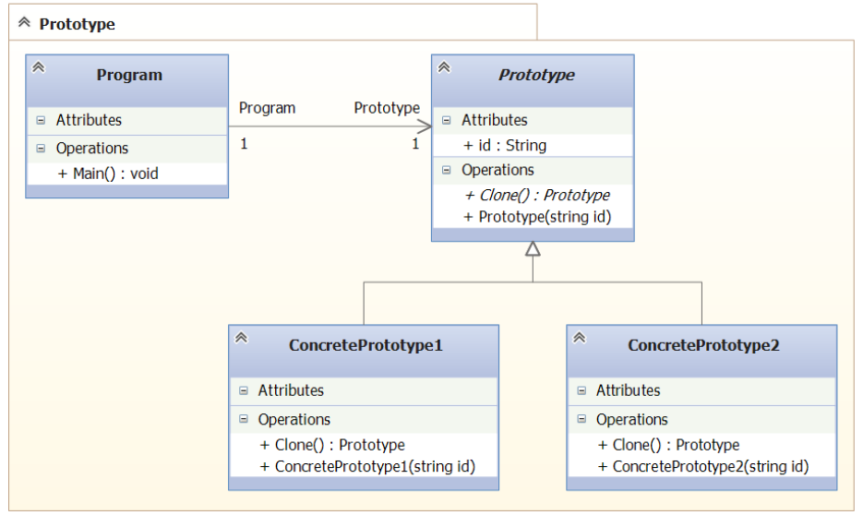
Prototype UML
Notes:
The participants:
Prototype - Provides an interface for cloning itself.
ConcretePrototype - Specific prototype: Implements the cloning operation itself.
Client - The client creates an instance of the prototype. Calls on the prototype method of cloning.

Slide 24
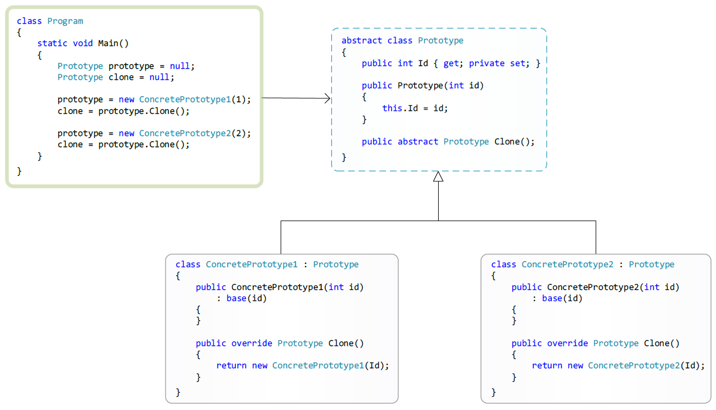
Prototype UML
Notes:
The most crucial moment when using the Prototype pattern is the implementation of the Clone method. Particular attention will be required if there are associations in the cloned prototype.
The Prototype pattern is expressed in the .Net platform as a cloning technique, through the use of the ICloneable interface implementation or the MemberwiseClone method of the System.Object class. But the MemberwiseClone method does not solve the problem of "deep and superficial cloning".

Slide 25
Prototype
Many features of using the Prototype pattern coincide with the features of the Abstract Factory and Builder patterns:
Hiding work with specific classes of products.
Ability to easily replace the families of products used.
Ensure the sharing of products.
There is a slight inconvenience in adding a new kind of product.
The possibility of changing the composition of the product.
Hiding the code that implements the design and presentation.
Control over the process of building a product.
The ability to add and remove products at runtime.
Description of new types of objects (class objects) by changing the state of clones.
Reducing the number of derived classes.
Dynamically adding classes at runtime.
Notes:
The Prototype pattern is recommended when:
The programmer does not need to know how the system creates, assembles, and presents the product objects.
The classes whose instances you want to create are determined at runtime, for example, using late binding technology (dynamic DLL loading).
You must avoid building parallel class hierarchies (factories or products).
Instances of a particular class can have a small number of states. Then it may be more convenient to install the prototype in accordance with each unique state and then clone the prototypes, rather than creating instances manually and not setting the state of these instances each time again.
You want to create a number of instances with the same long-calculated state. In this case, to improve performance, it is more convenient to create a prototype and clone it, using the MemberwiseClone method of the System.Object class included in the Microsoft .NET Framework. Cloning using the constructor will not improve performance.

Slide 26
Agenda
Abstract Factory
Builder
Factory Method
Prototype
Singleton (Solitaire)

Slide 27

Singleton (Solitaire)

Slide 28
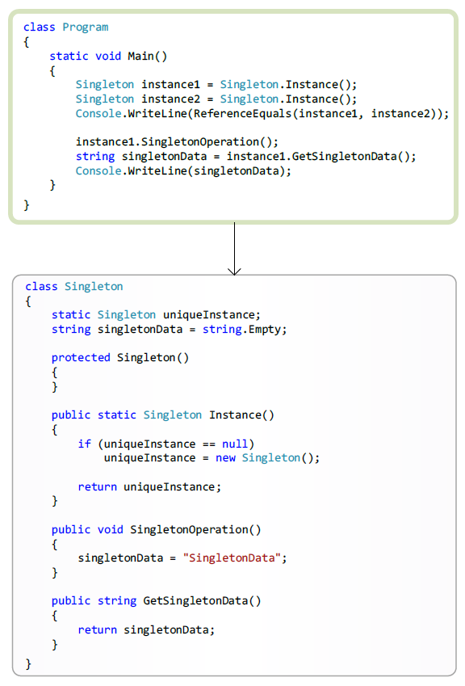
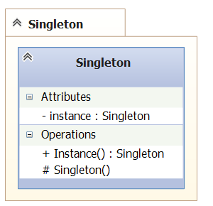
Singleton UML

Slide 29
Singleton
The Singleton pattern has the following advantages:
Notes:
The Singleton pattern is recommended when:
The algorithm for step-by-step creation of a complex product object should not depend on the parts of the product object and how these parts fit together;
The process of creating a product should provide the possibility of obtaining various variations of the created product.
The Singleton pattern has the following advantages:
Allows you to change the composition of the product.
The abstract class Builder provides the director with a set of abstract methods (abstract interface) for managing the construction of the product. Behind the abstract interface, Builder hides the internal structure of the created product and the process of building it. Since the product is built according to the abstract interface, it is enough to create a new type of builder to change the structure of the product;
Hides the code that implements the design and presentation.
The Builder pattern improves modularity by hiding the way that complex objects are constructed and presented. Clients do not know anything about the classes included in the internal structure of the product, the use of these classes is not available in the builder's interface. ConcreteBuilder's concrete builders contain the code needed to create and assemble a particular type of product. The code is written only once and different directors can reuse it to build different product variants from the same parts by combining these parts.
Provides full control over the process of building the product.
Unlike other generative patterns, which immediately construct the entire object-product completely, the builder builds the product step by step under the direction of the director. And only when the construction of the product is completed, the director or client takes it from the builder. Therefore, the builder's interface reflects the process of step-by-step product design more than other generative patterns. This allows you to ensure complete control over the design process, and therefore, over the internal structure (combination of parts) of the finished product.

Slide 30
Questions?

